Slide 1
Lecture #24
SOFT COMPUTING
INT508
Genetic Algorithm

Slide 2
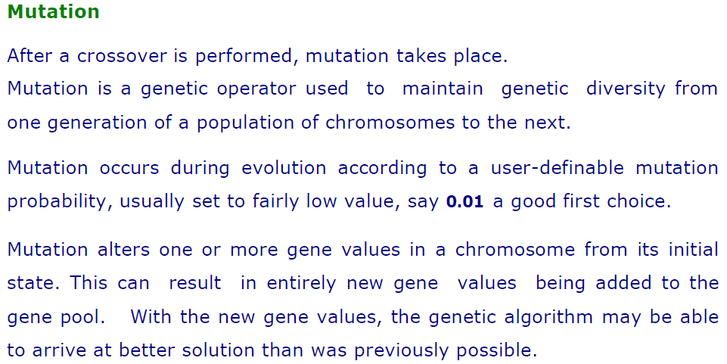
12/12/14
CSE510, Lovely Professional University, Phagwara

Slide 3
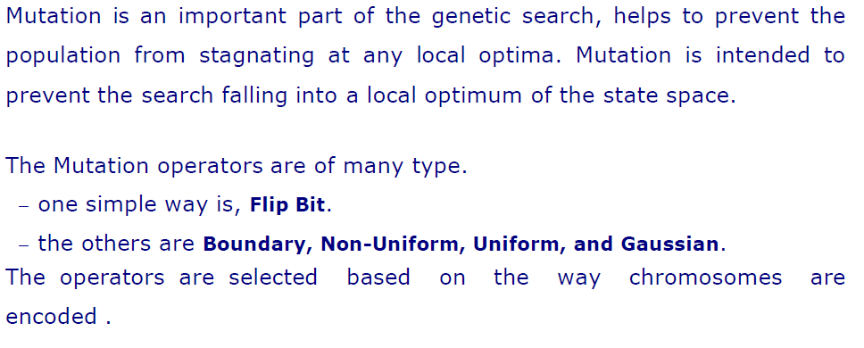
12/12/14
CSE510, Lovely Professional University, Phagwara

Slide 4
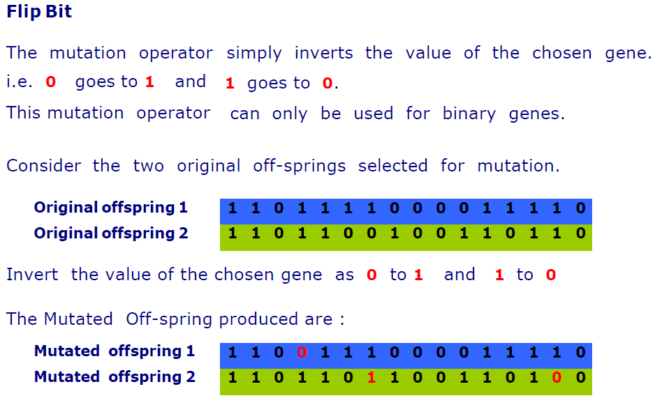
12/12/14
CSE510, Lovely Professional University, Phagwara

Slide 5
Random Resetting
Random Resetting is an extension of the bit flip for the integer representation. In this, a random value from the set of permissible values is assigned to a randomly chosen gene.
Swap Mutation
In swap mutation, we select two positions on the chromosome at random, and interchange the values. This is common in permutation based encodings.
12/12/14
CSE510, Lovely Professional University, Phagwara

Slide 6
Scramble Mutation
Scramble mutation is also popular with permutation representations. In this, from the entire chromosome, a subset of genes is chosen and their values are scrambled or shuffled randomly.
Inversion Mutation
In inversion mutation, we select a subset of genes like in scramble mutation, but instead of shuffling the subset, we merely invert the entire string in the subset.
12/12/14
CSE510, Lovely Professional University, Phagwara

Slide 7
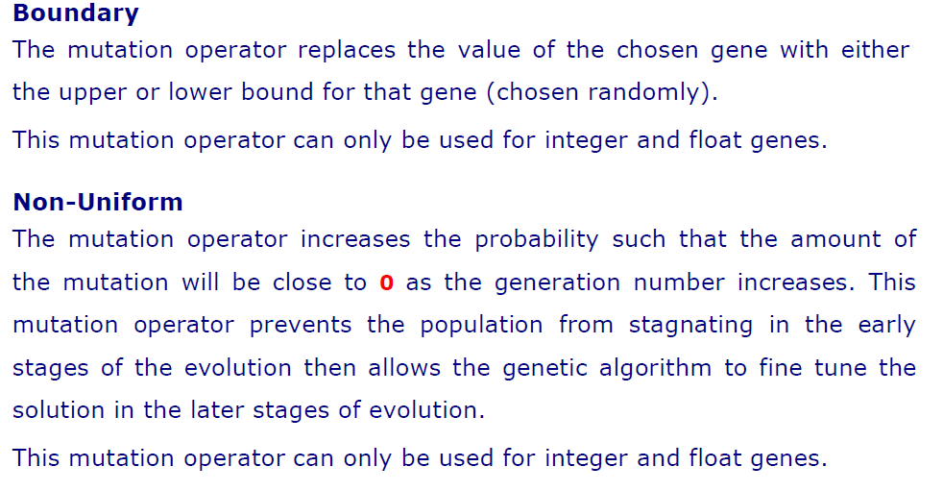
12/12/14
CSE510, Lovely Professional University, Phagwara

Slide 8
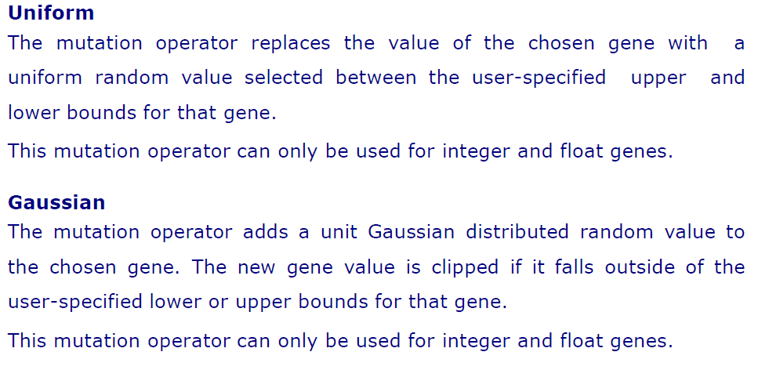
12/12/14
CSE510, Lovely Professional University, Phagwara

Slide 9
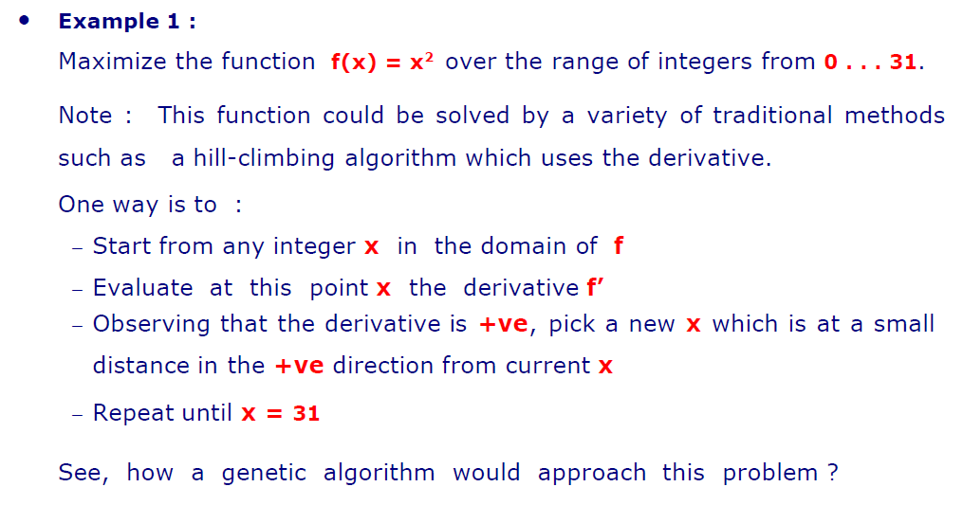
12/12/14
CSE510, Lovely Professional University, Phagwara

Slide 10
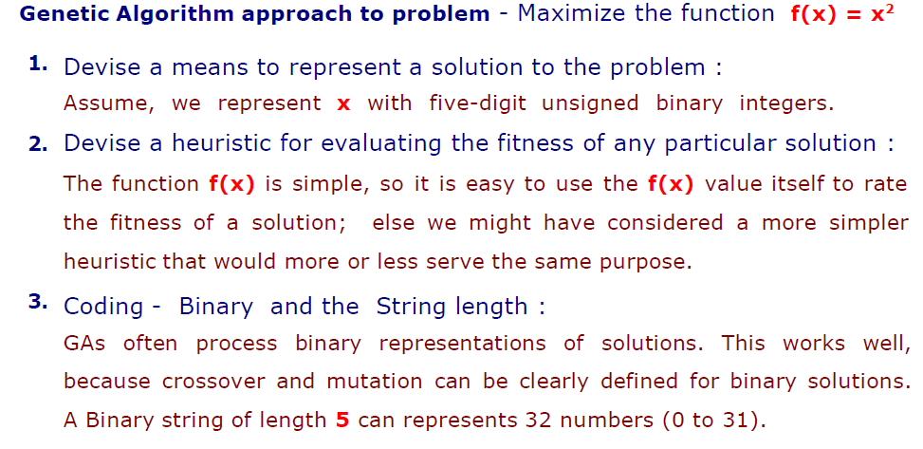
12/12/14
CSE510, Lovely Professional University, Phagwara

Slide 11
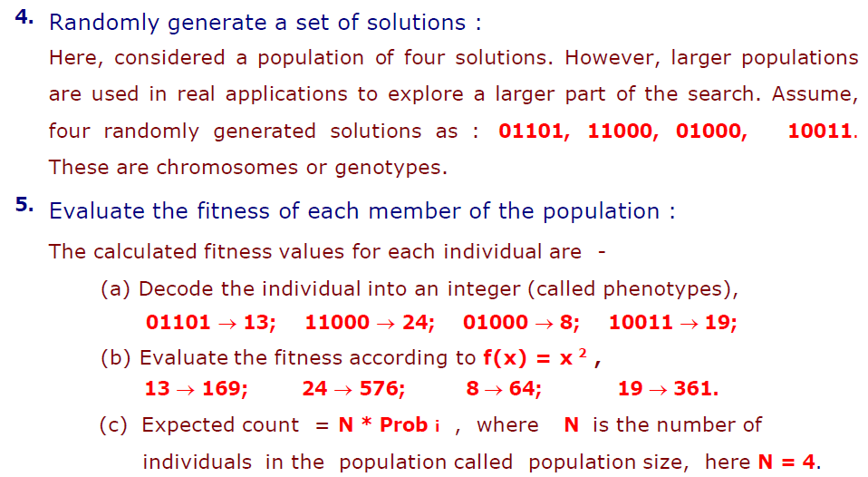
12/12/14
CSE510, Lovely Professional University, Phagwara

Slide 12
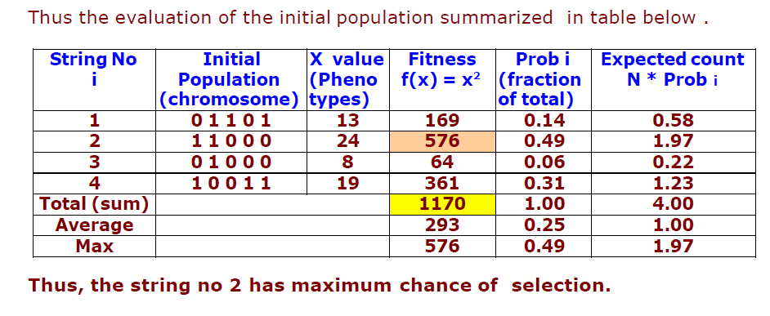
12/12/14
CSE510, Lovely Professional University, Phagwara

Slide 13
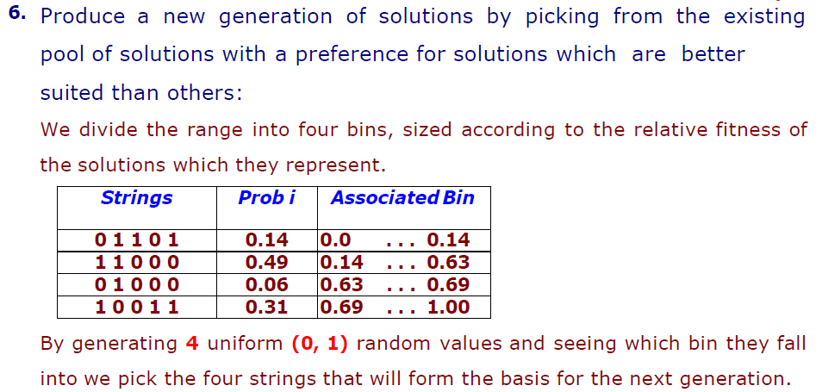
12/12/14
CSE510, Lovely Professional University, Phagwara

Slide 14
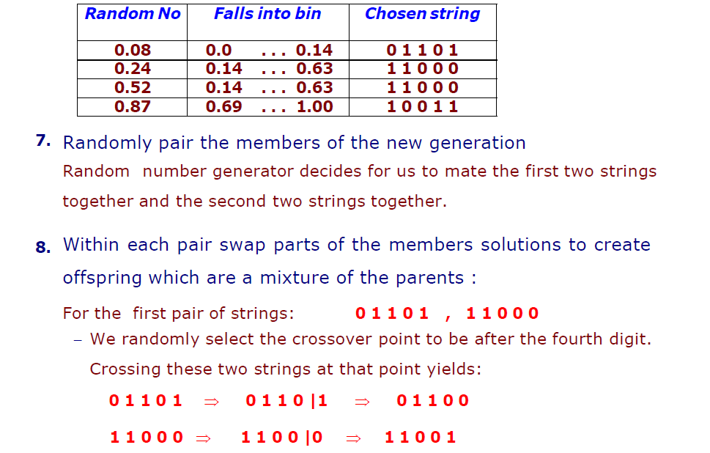
12/12/14
CSE510, Lovely Professional University, Phagwara

Slide 15
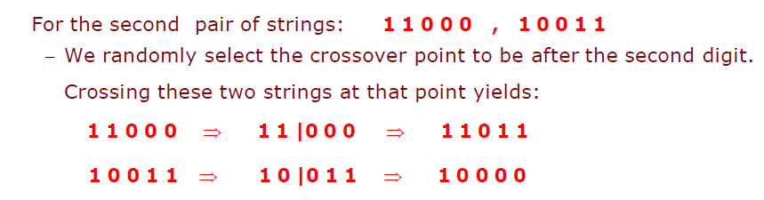
12/12/14
CSE510, Lovely Professional University, Phagwara

Slide 16
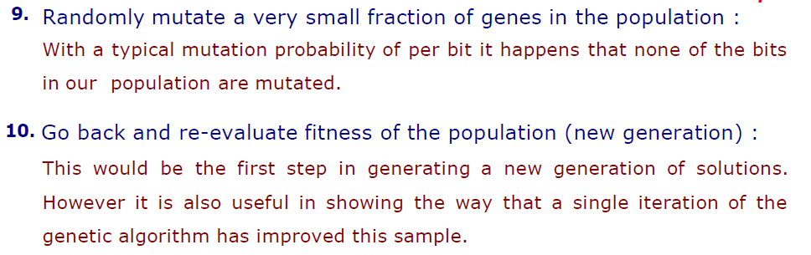
12/12/14
CSE510, Lovely Professional University, Phagwara

Slide 17
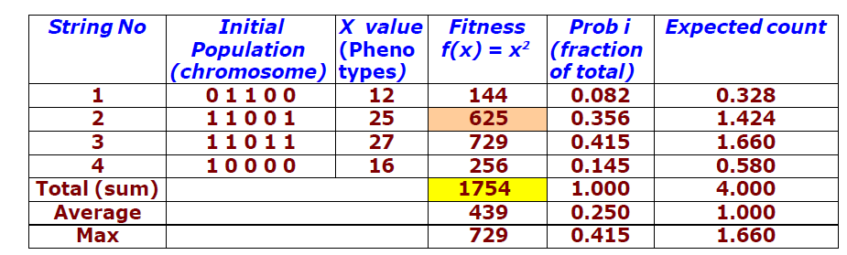
12/12/14
CSE510, Lovely Professional University, Phagwara

Slide 18
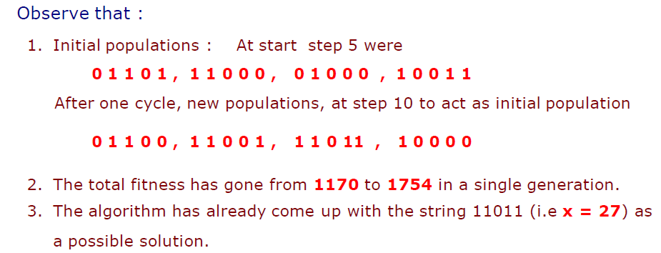
12/12/14
CSE510, Lovely Professional University, Phagwara

Slide 19
Q & A
1. Genetic algorithm is first introduce by_______.
A.charles darwin
B.john holland
C.gregor johan mendel
D.none of these

Slide 20
Q & A
1. Genetic algorithm is first introduce by_______.
A.charles darwin
B.john holland
C.gregor johan mendel
D.none of these

Slide 21
Q & A
2. Genetic algorithm belong to the family of method in the
A.artifical intelligence
B.optimization area
C.complete enumerat
D.Non computer based

Slide 22
Q & A
2. Genetic algorithm belong to the family of method in the
A.artifical intelligence
B.optimization area
C.complete enumerat
D.Non computer based

Slide 23
Q & A
3. What is the name of the process that represents modified elements of the DNA?
Selection
Mutation
Recombination
None of the above

Slide 24
Q & A
3. What is the name of the process that represents modified elements of the DNA?
Selection
Mutation
Recombination
None of the above

Slide 25
Q & A
4. Which of the following is the best representation of individual genes?
Coding
Conversion
Encoding
None of the above

Slide 26
Q & A
4. Which of the following is the best representation of individual genes?
Coding
Conversion
Encoding
None of the above

Slide 27
Q & A
5. Which of the following is not a specified method used for selecting the parents?
Tournament Selection
Steady-state
Elitism
Boltzmann selection

Slide 28
Q & A
5. Which of the following is not a specified method used for selecting the parents?
Tournament Selection
Steady-state
Elitism
Boltzmann selection

Slide 29
Q & A
6. Matrix crossover is also known as _________
One dimensional
Two dimensional
Three dimensional
None of the above

Slide 30
Q & A
6. Matrix crossover is also known as _________
One dimensional
Two dimensional
Three dimensional
None of the above

Slide 31

12/12/14
CSE510, Lovely Professional University, Phagwara

